Slide 1
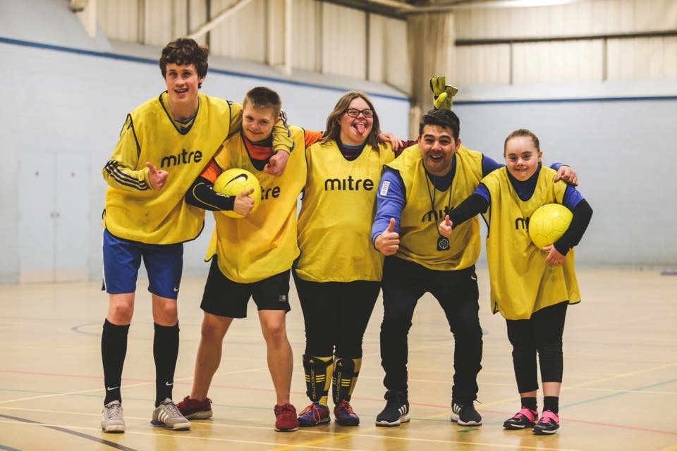
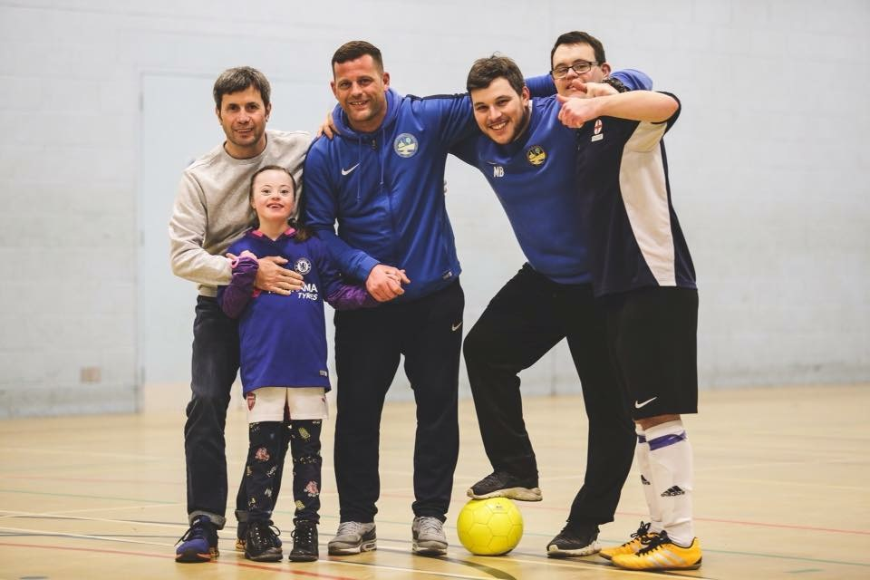
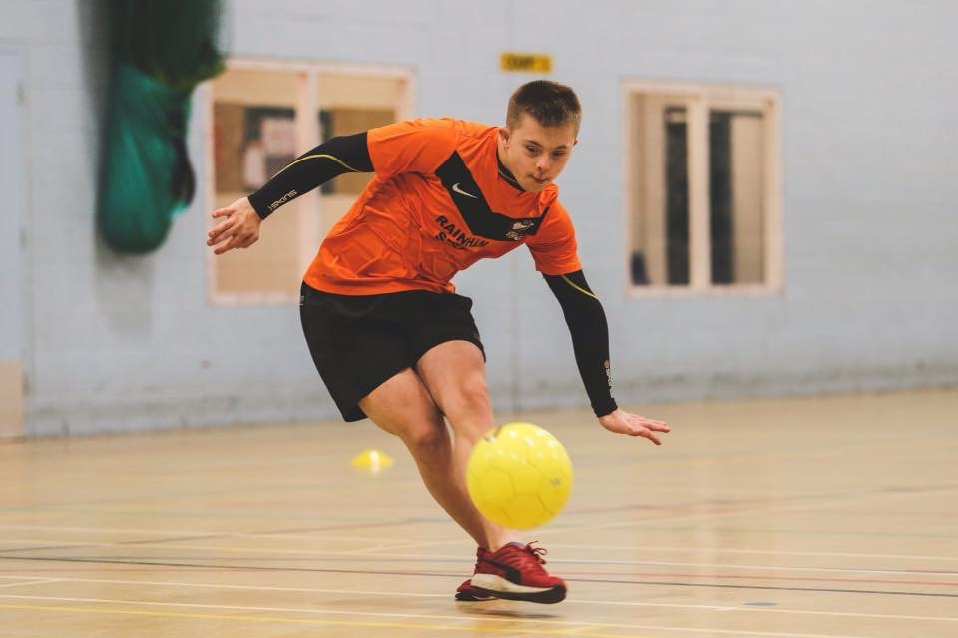
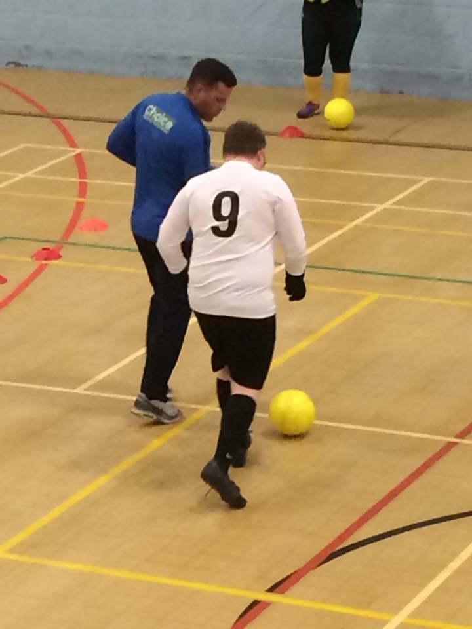
Bottesford Town DSActive Football Team
Football for teenagers and young adults with Downs Syndrome
Meet new friends and be part of a team
Access regular training sessions
Enter national football tournaments
Coached by trained, qualified, enthusiastic coaches
Suitable for all abilities – any age can attend training sessions
Sessions take place every Monday between 6pm & 7pm at
Bottesford Town Football Club, Scunthorpe
If interested, please email either:
Sueparkinson7464@yahoo.com or
stephen.altoft@talktalk.net
Or just turn up! Everyone’s welcome

